Slide 1
Wireless Capacitive Tactile Sensor Arrays for Sensitive/Delicate Robot Grasping

Slide 2
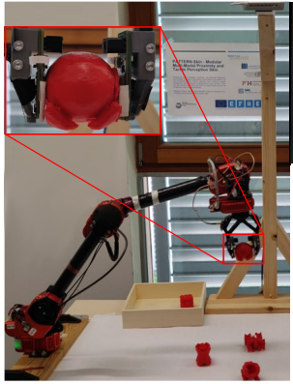
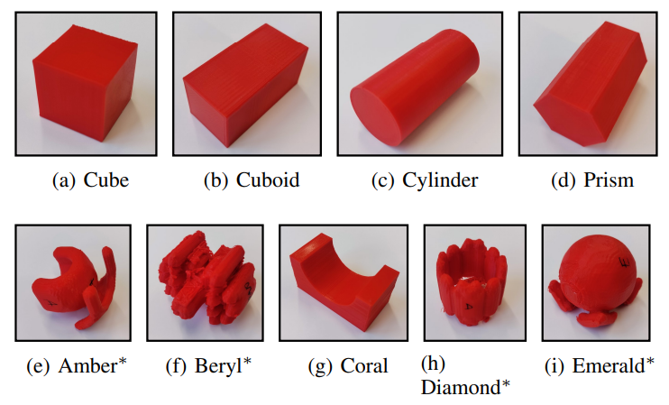
Motivation
It is hard to grasp objects of unknown shapes
Tactile sensors make it easier

Slide 3
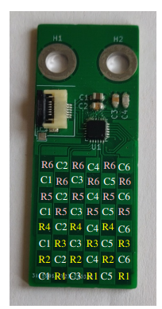
Solution
Customizable wireless Capacitive Tactile Sensor Array (CTSA) that allows to predict the success of grasps.

Slide 4
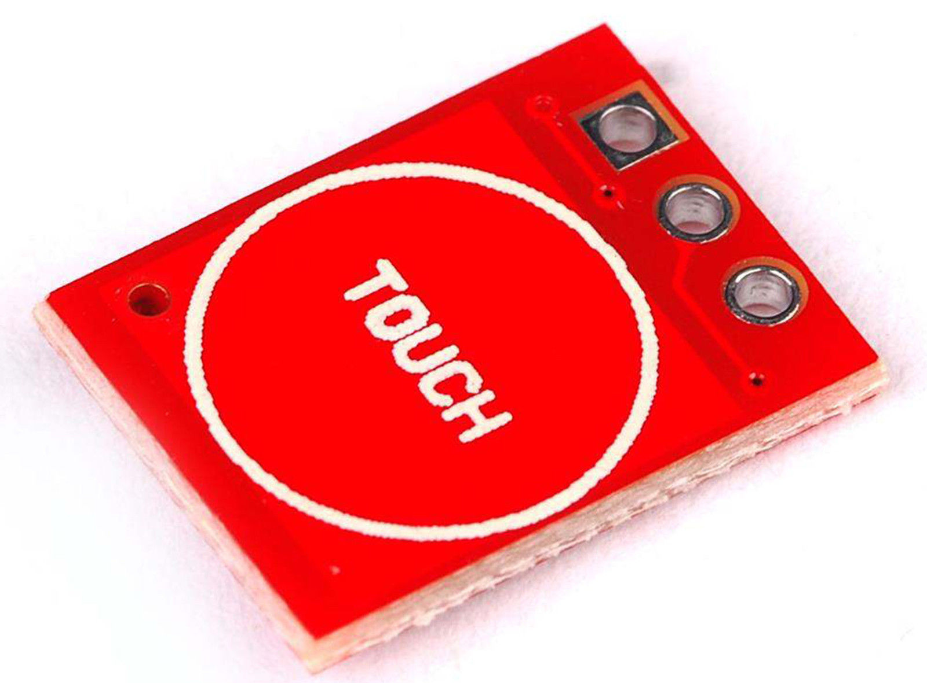
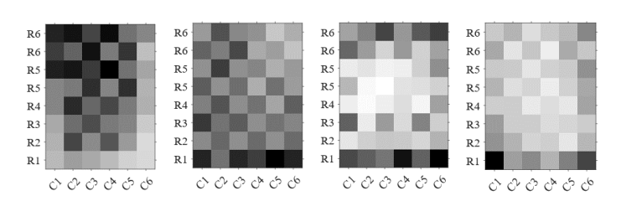
How does it work?
An array of capacitors. Their capacitance changes based on the distance between electrodes
Initial placement of gripper is determined from camera
Localizing the best grip position by applying small force
Use machine learning to infer the success of the grasp

Slide 5
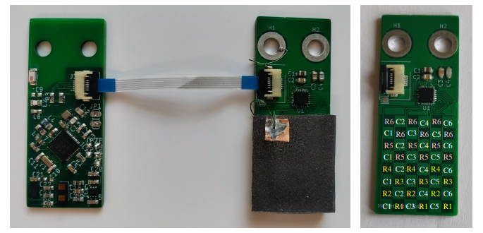
Sensor fabrication

Slide 6
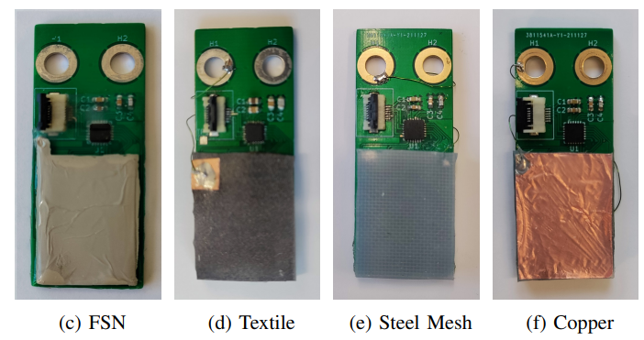
Sensor fabrication

Slide 7
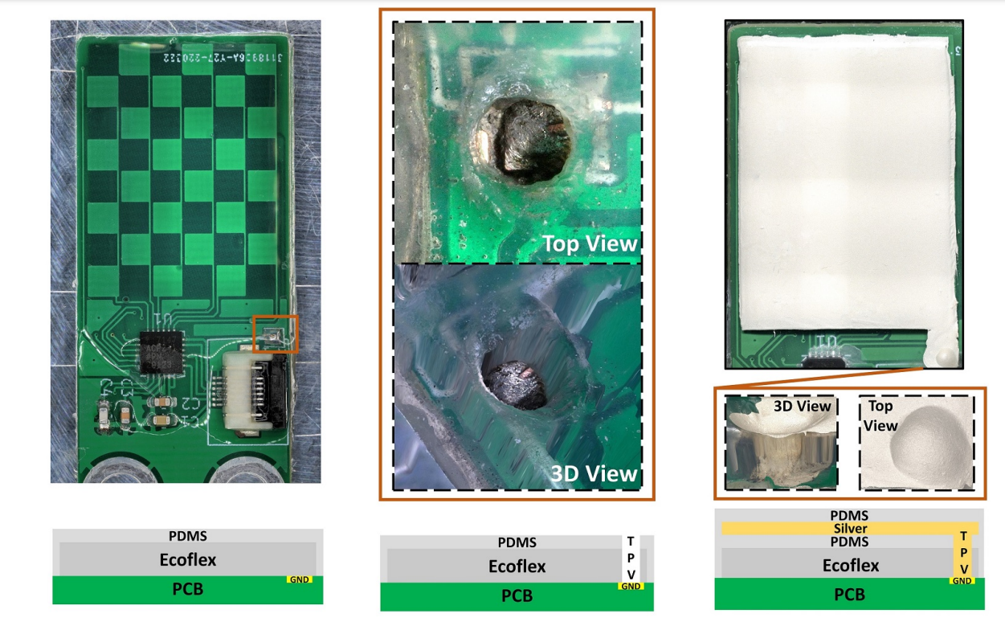
Sensor fabrication

Slide 8
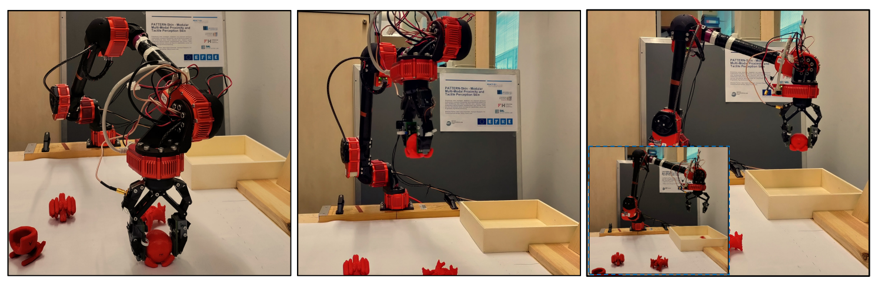
Experimental setup
One sensor was mounted in each side of the gripper
The sensors communicate via BLE with a base station
The measurements of the sensors are forwarded as ROS topics

Slide 9
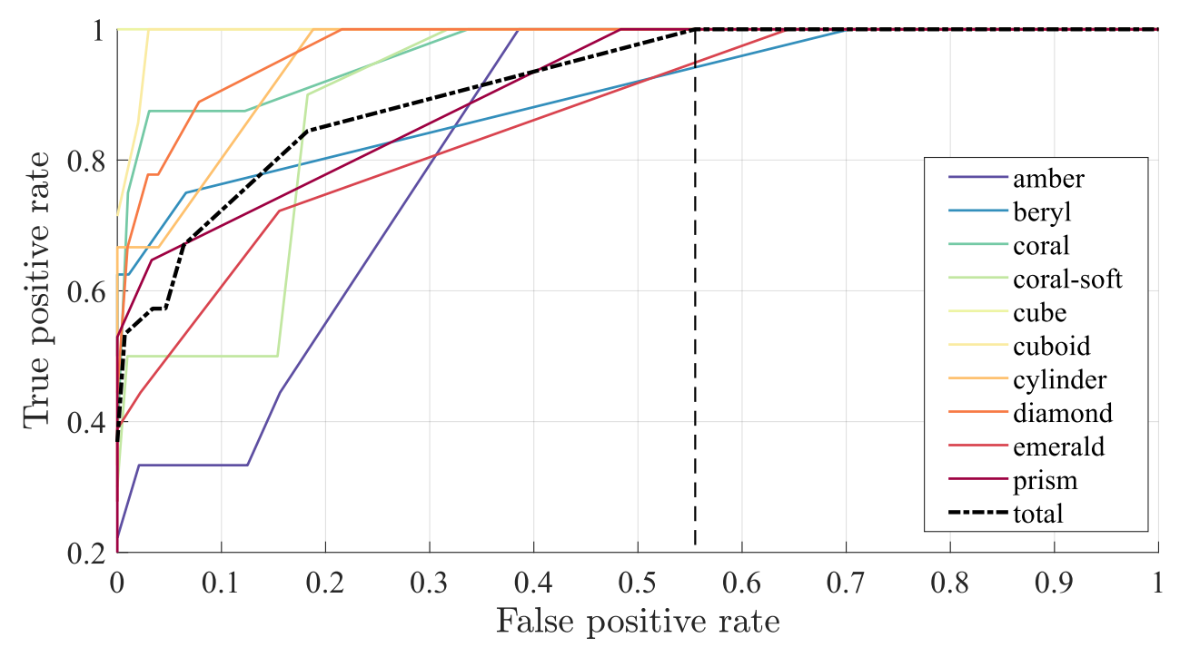
Results
100% true positive rate at 57% false positive

